Slide 1
Consensus of the ummah
اجماع امت

Slide 2
The Consensus of Muslim Ummah (Al Ijma)
Meaning
Definition
Status of Ijmah in the light of Qur’an & Sunnah
Examples of Ijmah (contemporary: Declaration of QADYANIS as Non-Muslim)
Conditions & Criteria
Types of Ijmah

Slide 3
Meaning of IJMAH
Literal meaning
In sharia terminology
Ijmah is to agree and to concur. determination, resolution and agreement
upon something
“The agreement of the mujtahids (jurists) from among community of Muhammad (peace be upon him) after his death in a certain period of time upon a rule of Islamic law.”

Slide 4
Proof and Justification of Ijma’ as a Source of Islamic Law.
The Qur’an: “ O ye who believe! Obey Allah and Obey the Messenger and those charged with authority among you. If ye differ in anything among yourselves, refer it to Allah and His Messenger…” (al-Nisa’(4):59)
The word ‘uli al-amr means ulama’ (scholars) of the community. Thus the agreement of the mujtahids is bound to follow.

Slide 5
Proof and Justification continue… The Sunnah
There are many Sunnahs indicated that the Muslim community is infallible in their
agreement.
• “My community will not agree on mistake.”
• “My people will not agree on an error”
• I prayed to Allah, the Exalted, that my community may not agree on error, and He gave it to me.”
• “Allah’s hand is over the community
Although each of this Sunnah is probable if it stands independently but collectively they
are definitive and convey the same idea. This make adherence to ijma’ is obligatory on the muslims

Slide 6
Conditions for the validity of ijma’

Slide 7
Conditions
The agreement must take place among mujtahids
Mujtahid is a person who is qualified to exercise ijtihad
The agreement must be unanimous.
The mujtahids must belong to the Islamic community.
The agreement of mujtahids must be held after the death of Allah’s Messenger (peace be upon him)
The agreement must be among the mujtahids of one period, even though some mujtahids of subsequent periods may differ from them.
The agreement should be held on a rule of Islamic law (in legal matter).
The mujtahids should have relied upon a sanad for deriving their opinion. Sanad is the evidence (proof) upon which the mujtahids rely on, for arriving upon an agreement.

Slide 8
Types of Consensus
Practical
الاجماع العملی
Silent
الاجماع السکوتی
Verbal
الاجماع القولی

Slide 9
Verbal Consensus
If this consensus came down by way of speech, where the MUJTAHIDEEN had verbally specified the issue.
That is they said that they are unanimous on so and so issue or if each one of them had individually acceded to the fact that he is in agreement or that his mazhab confirms to it.

Slide 10
2) Silent or tacit ijma (ijma’ sukuti):
It takes place when some mujtahid, one or more, give a legal opinion with regard to specific rule about a particular legal issue,
then the rest of them are informed of this opinion and they keep silent and they neither acknowledge it nor object to it.

Slide 11
The levels of Consensus
1 )The ijmah of Sahaba (Unanimity of the companions of Prophetﷺ)
2) Ijmah-e-Tabeen (Unanimity of the followers of the companions)
3)Ijmah-e-Ummah (Unanimity of the nation)

Slide 12
Examples of Consensus
The collection of the Qur’an in a single volume.
The second azan on Friday.
The decision to not distribute land in Iraq among the conquerors

Slide 13
The Transmission of Ijmah
Acquired
Manqul
This is established through reports which may be ahad or Mutawatr.
This is direct participation of a mujtahid in the consensus without any transmitters

Slide 14
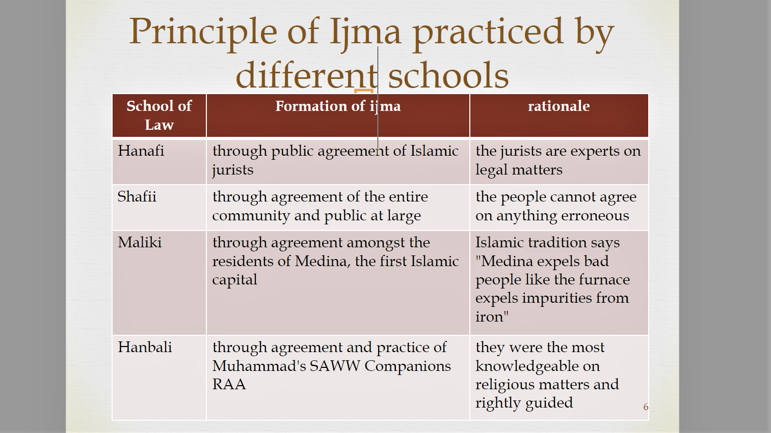

Slide 15
Conditions
The agreement must take place among mujtahids.
Mujtahid is a person who is qualified to exercise ijtihad.
The agreement must be unanimous.
The mujtahids must belong to the Islamic community.
4. The agreement of mujtahids must be held after the death of Allah’s Messenger (peace be upon him).

Slide 16
Conditions continue
The agreement must be among the mujtahids of one period, even though some mujtahids of subsequent periods may differ from them.
The agreement should be held on a rule of Islamic law (in legal matter).
The mujtahids should have relied upon a sanad for deriving their opinion. Sanad is the evidence (proof) upon which the mujtahids rely on, for arriving upon an agreement.

Slide 17
Types of Consensus
Basically consensus is of three types:
Verbal الاجماع القولی
Practical الاجماع العملی
Silent الاجماع السکوتی

